Slide 1

Analyzing the Impact of car features
Data Analyst | SNEHIL GUPTA

Slide 2

Project description
The automotive industry has been rapidly evolving over past few decades with a growing focus on fuel efficiency, environmental sustainability and technology innovation. With increasing competition in market manufactures wants to change consumer's landscape.
This project aims to analyse the car features that effect the manufacturers car’s price. As a Data Analyst, the client has asked that how can a car manufacturer optimize pricing and product development decisions to maximize the profitability while meeting consumer demand.
The dataset contains information on various car models and their specifications, titled as “Car Features and MSRP”. Dataset is available on Kaggle by Cooper College, New York City.
  Total no. of Observation : 11,813
  Total no. of Variables :
  File type : CSV

Slide 3
Project description
I assumed the NA values are valid values to dataset.
I used Power Query and pre-processing to clean data as follows :
  Filtered out the data from blanks cell.
  Found and replaced the numeric values in Car Model variable.
  Removed cluttered and missing value rows.
  Apply the performed changes.
I assumed highway MPG more relevant variable than city MPG because on highway car gives more mileage than in city.

Slide 4

Approach
For analysis I used descriptive statistics, regression analysis and visualization to visualize the charts and graphs.
The reason behind using descriptive analysis was to find out the mean of car’s features variable and then to visualize them in form of charts and graphs.
Regression Analysis told the dependency of independent variables to dependent variables i.e., the specific features of car impact the car’s price.
While creating the charts it was difficult to summarize the values of variables in sum or average.

Slide 5

Tech stack - used
MICROSOFT EXCEL 365
All the analysis has been done on Excel sheet(office 365), Windows 11. Excel as tool used to create all visualization and graphs to better understanding the results i.e., insights.
It mentioned in project to use only excel to perform analysis.

Slide 6
Insight – popularity of a car
**From below line chart we can see in market category Hatchback and Fuel Flex are the highest populated and having highest number of car.

Slide 7
Insight
**From below Scatter plot we can see cars which have high enigne power having higher price. Thus, car’s power increase car’s price will also increase.

Slide 8
Insight - Regression analysis
**From below Bar chart we can see Engine Cylinders having the strongest relationship with the MSRP.

Slide 9
Insight
**From below Bar chart we can see Car brand Bugatti and Bentley having the highest average price

Slide 10
INSIGHT
**From below scatter plot we can see that no. of cylinders having 4 is giving maximum fuel efficiency. Fuel efficiency is inversely proportional to no. of cylinders, higher the no. of cylinder lower the fuel efficiency.

Slide 11
insights
**From below Stacked column chart we can see the body style of Chevrolet and Mercedes Benz having highest contribution in car’s price.

Slide 12
insights
**From below Clustered column chart we can see Coupe style of Bugatti and Convertible style of Maybach having highest no. of average car’s price.

Slide 13
insight
**From below scatter plot we see the automated convertible and automated_manual coupe are highly contributing in MSRP.

Slide 14
insight
**From below Line chart we can see as time increased fuel efficiency(Highway MPG) also increased or improved.

Slide 15
insight
**From below Bubble chart we can see the car which have high engine hp their price are also getting high and cars which have high highway MPG their price getting low. Thus, higher the engine power higher the price.

Slide 16
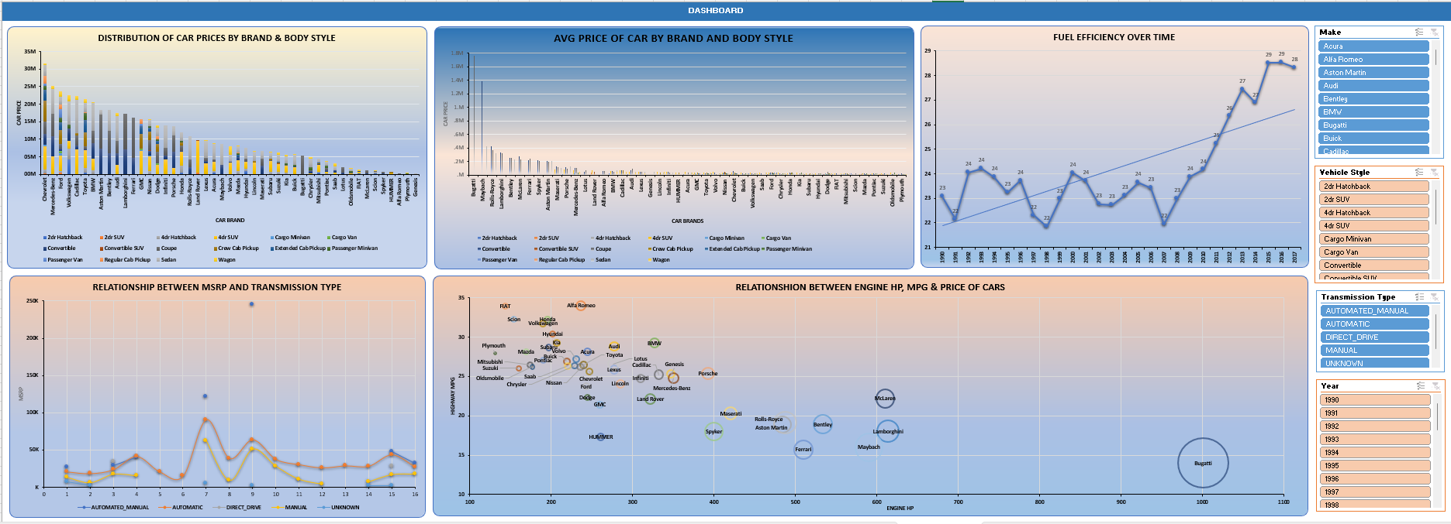
dashboard

Slide 17
result
Coupe body style contributing maximum in car’s MSRP.
In transmission type automated_manual creating high impact because in a single car having both automated and manual gear system will more beneficial rather than single gear system.
Companies needs to produce high or at least good fuel efficiency of cars by which majority of the class can afford a car.
Overall, fuel efficiency and Coupe body style features highly impacting the car price and profitability.
Click on the below link to get excel file and get all analysis in depth.
https://docs.google.com/spreadsheets/d/1eyamrp8rKwEwy_XBswK9hX2YU4IFJBiO/edit?usp=share_link&ouid=115023544395956487548&rtpof=true&sd=true

Slide 18
thankyou

